Slide 1

SUNSAR LOGISTICS PRIVATE LIMITED
WELCOME TO SUNSAR

Slide 2
Introduction
Sunsar Logistics is the corporation genesised from Ramda Foods. It was established in 2020 & currently strategic partner in Warehousing & Transportation in India. We are specialize in Transport, Warehousing , Logistics, Packers & Movers, and Door to Door Services
With Reliability & Timely services, the company has grown progressively to becoming a major & reliable player in the sector. It’s currently serving client in all continents of the world offering tailor-made services suitable for individual needs that start from the point of origin through various custom procedures to the client’s doorstep and ensures that clients get personalized attention.
Sunsar Logistics has a highly experienced and professional team which offers full range of Logistics, Warehousing, Transportation services and supply chain solutions to our customers in many market sectors.
Distributions:
Local Trucking (Truck Types include : 4, 8, 10, 12, 15, 20, 25, 30, 35 & 40 tons) & Part Load.
Cross Border Trucking (Truck Types : 14, 17, 20, 22, 24, 28, 30, 32 FT Single & Multi Excel)
Real time status with Global Positioning System (GPS)

Slide 3
Services
Transportation
Warehousing
Goods Transportation
Train Transportation
Door To Door
Packaging & Movers
Office Moves
Household Moves

Slide 4
The Company
The company has invested tremendously in the latest & relevant technologies in regard to communications, Tracking, Transfers, Transport, Warehousing, Packaging & Storage with SUNSAR LOGISTICS, so goods are not only secure with SUNSAR LOGISTICS, but clients always remains informed as to the where about their goods all through the way.

Slide 5
Core Values
Timeliness
Sense of Urgency
Integrity
Caring Attitude

Slide 6
Values
Timeliness : We thrive on challenges and perform our activities with high sense of urgency.
Integrity : We are honest and trustworthy. We accept responsibility for our actions and follow through on promises & commitments.
Quality : We take pride in what we do and deliver high quality service to our clients and partners.

Slide 7






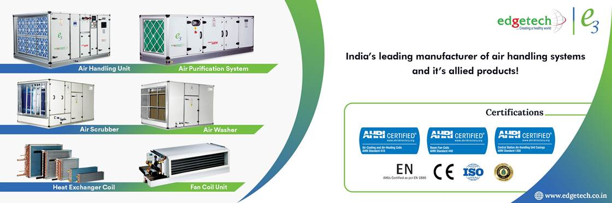

Our Clients

Slide 8
Vision
To be the problem solver and market leader by offering reliable ,cost effective and secure worldwide logistic solutions Where our customers feel benefited and satisfied through our professional behaviour and personalized relationships.
Mission
To be provide plethora of choice for innovative and qualitative logistical solutions.

Slide 9
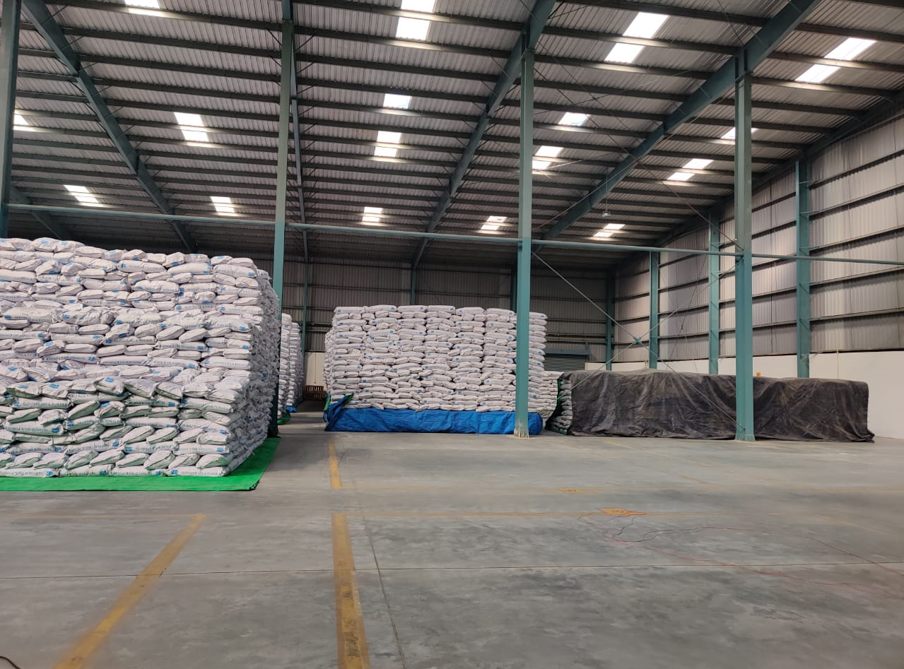
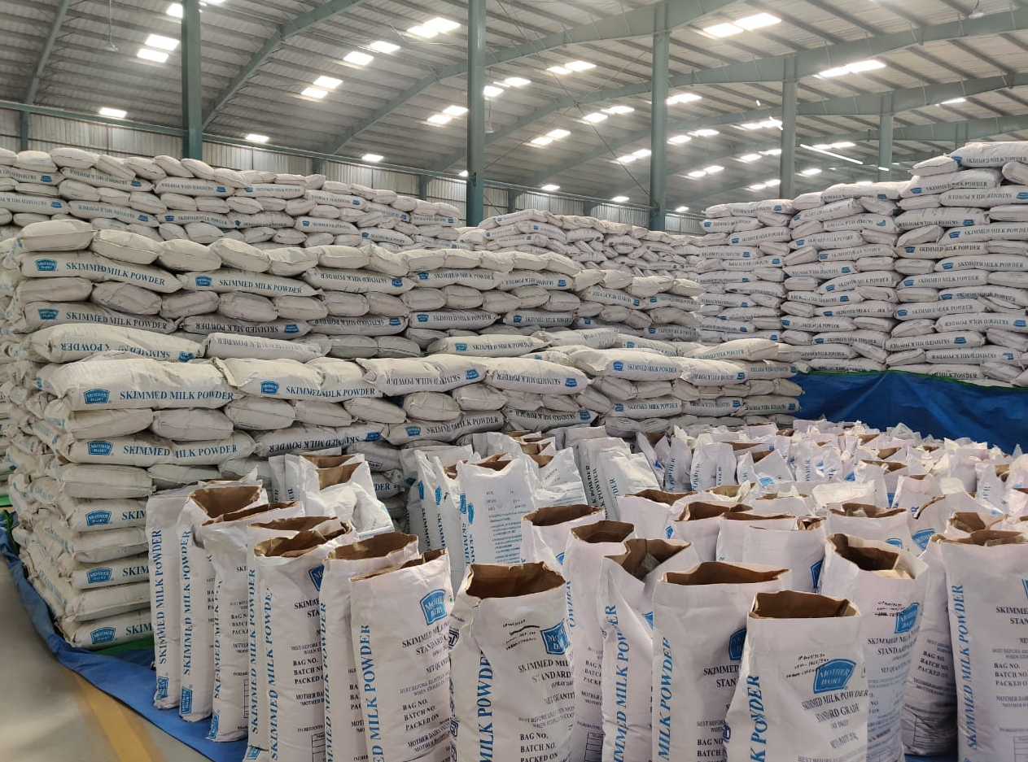
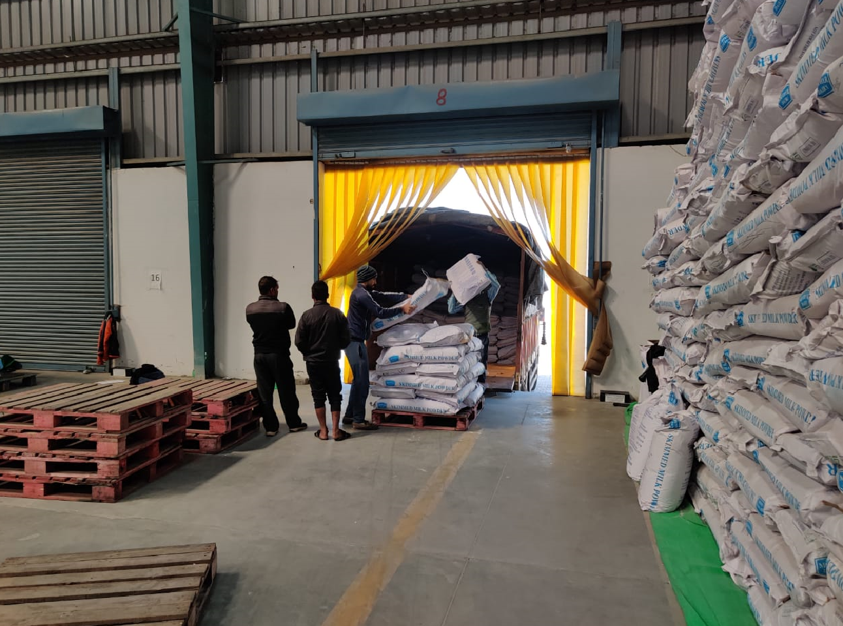
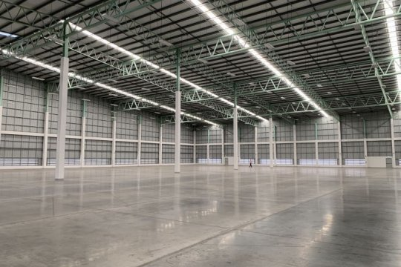
Warehousing
We provide secure & spacious warehousing & logistics support.

Slide 10
Rates
Our rates are very competitive in the market.
They are negotiable based on transport / cargo volume.
They are no hidden charges on our rates. Our quotation are detailed & self explanatory.
Corporate Office : Plot No 1/7, SSGT ROAD
Industrial Area, Near Metro Mall Compound
Lal Kuan, Ghaziabad, (U.P.) - 201009
Call & WtsApp:9811392929, 9810413939, 7678347554
Email : info@sunsarlogistics.com

